Slide 1



Productivity Manager
Team Details:
1) Ujjawal Patel (16010121139)
2) Avneesh Pillai (16010121147)
3) Yakshit Poojary (16010121149)

Slide 2

Problem Statement
To write a program where the user enters their timetable for the week/day and it sends a notifications to the user about the task according to the day and time entered by the user. Also an extra functionality of the program is to notify the user about extra assignments or submissions at frequent intervals of time.

Slide 3

System Architecture
In order to fulfill this problem statement, we used a few libraries like time, schedule, notifypy, random and pandas.
We prompt the user to provide their timetable to the system.
Further we mold their input provided into a format that can be interpreted by our code and a suitable and accurate response can be provided to the user, in our case the user is notified at the correct time about their task.

Slide 4

Features of designed system
We try to create a basic functionality that is similar to a reminder software wherein the lectures/tasks are reminded at the specified time.
We collect information about the assignments or submission they have in line and notify them about the same during the day.

Slide 5
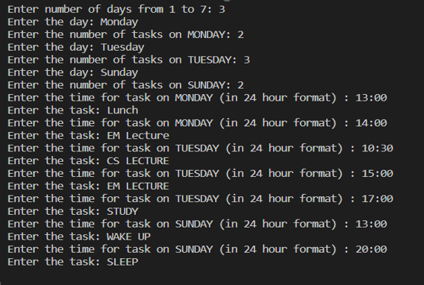
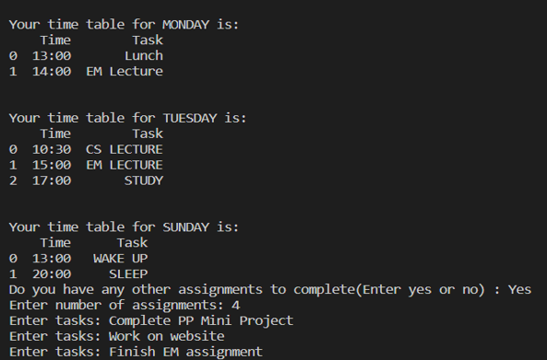
OUTPUT

Slide 6
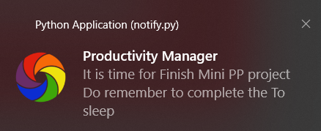
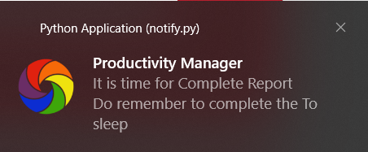
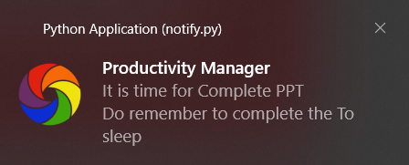

Slide 7
Conclusion
With the help of this project we try to resolve the everyday problem of losing out on the completion of tasks on time.
We also help the user to ensure that they have their tasks/assignments/projects completed/submitted in time which results in a good production schedule.

Slide 8
References
https://www.geeksforgeeks.org/python-schedule-library/
https://www.geeksforgeeks.org/python-pandas-dataframe/#:~:text=Pandas%20DataFrame%20is%20two%2Ddimensional,fashion%20in%20rows%20and%20columns.
https://www.w3schools.com/python/module_random.asp

